Slide 1
Watson Solution Patterns Overview Social CRM (Twitter BOT)
Business problem
Watson value proposition
Sample demo
Key client discussion points
Qualifying the client
Elevator pitch
Solution Architecture and Bill of Materials

Slide 2
Watson Social CRM on a Page (Vision)
Symptoms
Today: Contact centers are managing more channels and channel management is getting more complex. Ineffective social efforts don’t change the metrics or contact volume.
A better approach is needed.
Poor customer experience
High Cost
High Customer Churn
High Agent turnover
Agent Training costs
Channel Complexity
Watson Social CRM can support multiple social media outlets in these Target Industries:
Telecommunications
Airlines
Financial Services
Media
Retail (high velocity, major chain)
Results
Tomorrow: Watson Social CRM will provide users with a consistent, unique and personal way of engaging with the organization via a variety of channels.
Contact Deflection
First Contact Resolution
Answer Consistency
Cross/up sell opportunities
Customer satisfaction
Net Promoter Score (NPS)

Slide 3




Applying Watson to engage with customers on prominent social channels will deflect calls from the call center and favorably impact NPS
Reduce Operating Cost | Improve Customer Satisfaction | Increase Opportunities To Sell | Reduce Customers At Risk
1
Quantitative KPIs
2
Qualitative Drivers
Increase Contact Deflection
Increase Customer Retention
Net Promoter Score (NPS)
Increased customer satisfaction
Customer engagement insights
Consistency of answers across channels
Increase Life time value

Slide 4
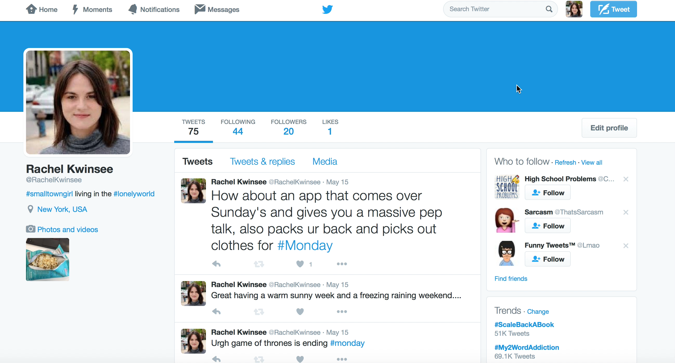
Video of the Demo leveraging a test/training Twitter handle*
Live Demo Script
Log on to one of the dummy Twitter accounts:
@rachelkwinsee pwd: annaknaster
Tweet: @WatsonTelcoBot my mobile has no service. Called in and had to wait 20 minutes. Worthless.
Wait for 1st tweet– what Watson is doing:
Intercepting the tweet
Understanding Natural Language, context, location, sentiment, tone
Wait for 2nd tweet– what Watson is doing:
Watson is plugged into NOC to provide immediate relevant update
Tweet: @WatsonTelcoBot back up and running
Wait for reply – what Watson is doing here:
Watson is improving customer retention by ensuring providing promotion
Watson looked at all the customer’s tweets and saw this person it’s usually negative
* For production systems, we leverage actual client twitter handles

Slide 5







Watson Social CRM delivers consumer success; is preferred by emerging customer groups and unifies channels for consistent performance
Mobile
Chat
Retail
Agent
Email
Forums
Web
Millennial
Preferred
Improved Information Sharing
Scalable and Flexible
Unified Metrics
In a recent 13-week test at Georgia Tech the Bot was undistinguishable from human responses and perceived as “cool” and interesting
Being able to use content and response data across channels provides better, faster response management and improves answers across all channels
BOTs can handle times of high demand more easily; responding to the ebb and flow of the business, with rapid, consistent and timely interactions
The questions, answers patterns, volume and trending can all be combined and viewed consistently for better operational management.

Slide 6
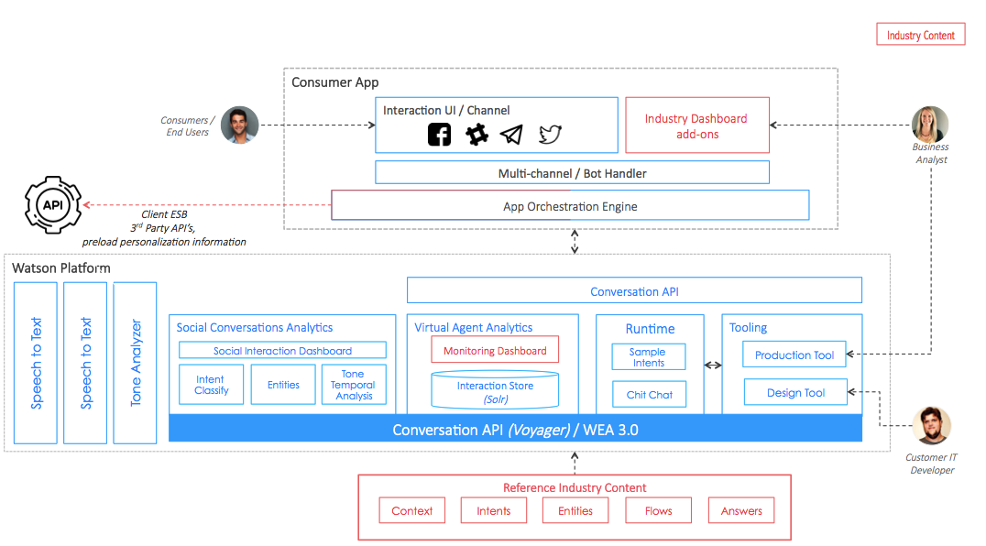
Solution Architecture and Bill of Materials
Watson Engagement Advisor 3.0 (till Conversation comes GA / stable)
Watson Conversation API
Watson Speech to Text
Watson Tone Analyzer
Bot Integration Framework (3rd party or custom)

Slide 7
A checklist for sellers to qualify the client
Key Criteria |  | Optimal Candidates Look Like:
SPONSORSHIP: |  | Chief Digital Officer, Chief services officer, Marketing or CRM leader are roles that have the best span of control to make the decisions that drive success
VISION: |  | Understanding the impact of Watson technology and processes requires a bold vision, not an incremental one
BUDGET: |  | Being able to undertake a pilot is a great place but ensuring there is plan for broader roll-out up front drives faster adoption
CHANNEL DIVERSITY: |  | Increased channels offer a greater transformation opportunity through cognitive approaches
ADOPTION EFFORTS: |  | Understanding client processes and success definitions enable development of transformational processes and metrics
CUSTOMER EXPERIENCE: |  | A Watson-driven digital transformation combines channels seamlessly with shared metrics. Delivering these requires multiple domains working on shared platforms and information
BRAND REPUTATION: |  | Companies seeking to improve reputation or maintain leadership positions are better candidates. Success occurs customer experience and innovation are on executive agendas.

Slide 8
Elevator Pitch for Social CRM
Watson can be the IVR of the digital age
The digital world is people communicating via text, chat bots, social media, twitter, any kind of digital communication
Many of these channels are not in your control but are in the public domain, so without having people monitoring, Watson can help you monitor these channels
This Watson-enabled digital IVR allows you to understand natural language, emotion, intent, and tone
A dashboard shows the classification of real tweets that the organization handles
You can see that the tweets are being classified and assessed in real time as they’re coming in
Emotional and Social tones show the distribution of tweets across those categories from cognitive psychology, information that helps inform the type of reply that can be received best
FAQs
What is the client buying?
A 1-year subscription to Watson Explorer license and Watson Developer Cloud Platform which will enable the client to develop the Social CRM pattern
How much does it generally cost?
$250K for 1-year subscription & 4 weeks to deploy an initial pilot
How does the solution get implemented?
There are two options:
Self-Serve: 1-week enablement session for client developers with education on the solution pattern. After which, client IT teams then develop/deploy the solution in a self-serve mode.
Professional Services: Hire IBM or use system integrator to develop

Slide 9
Start NOW. Continue with intense focus and deep passion for success.
1.
Target solutions for your accounts
Review materials
Solutions Card
Seller’s Brief
Demo + Script
Customize your messaging and materials
Prepare your pitch
Practice using the demos
2.
Determine your client customization
Determine which patterns work best
Request customized demos for solutions most relevant to industry and account (SC number needed)
Determine data and content sources
3.
Conduct your meeting with confidence
Effective, well rehearsed demos (video alternatives)
Direct, relevant slides
Ability to move quickly to sales process
And please be sure to give us your feedback!

